Slide 1



DHANALAKSHMI COLLEGE OF ENGINEERING
(An Autonomous Institution)
Department of Computer Science and Engineering
Final Project Review
AI RESUME ANALYZER FOR JOB DESCRIPTION
DOMAIN : ARITIFICAL INTELLIGENCE (AI)
GUIDED BY,
Mr . T. SELVAPRABHU, B.Tech, M.E, (Ph.D).,
ASST.PROFESSOR – CSE
DHANALAKSHMI COLLEGE OF ENGINEERING
SUBMITTED BY:
1. AVULA KIRAN [410721104018]
2. GAJJALA SAGAR REDDY [410721104035]
3. GUTHA SURYA PRAKASH [410721104042]
4. I. ABHINAY REDDY [410721104047]

Slide 2
Abstract:
The AI Resume Analyzer is a powerful recruitment tool that automates the process of comparing resumes with job descriptions, ensuring efficiency, accuracy, and fairness in candidate screening. It leverages Natural Language Processing (NLP) techniques, including Term Frequency-Inverse Document Frequency (TF-IDF) and Cosine Similarity, to analyze and match resumes against job requirements. By extracting key skills and measuring similarity scores, the system provides an objective evaluation of candidate suitability while also identifying missing skills that may be crucial for the role. The AI Resume Analyzer helps eliminate unconscious bias, ensuring a more inclusive and diverse recruitment process. By relying purely on data-driven insights, it enables organizations to make informed hiring decisions without the influence of subjective judgments.

Slide 3
Introduction :
The AI Resume Analyzer is a transformative tool designed to revolutionize the recruitment process by automating the tedious task of comparing resumes with job descriptions. By leveraging advanced algorithms and Natural Language Processing (NLP) techniques, it empowers recruiters to identify suitable candidates quickly and efficiently while minimizing effort and eliminating bias. In today’s competitive hiring landscape, where organizations receive hundreds, sometimes thousands, of applications for a single role, this tool proves invaluable for ensuring accurate, unbiased, and streamlined hiring decisions.

Slide 4
Objective:
Here is to develop an AI-powered Resume Analyzer that automates and enhances recruitment by efficiently comparing resumes with job descriptions using Natural Language Processing (NLP) techniques like TF-IDF and Cosine Similarity. The system aims to streamline hiring by reducing manual effort, improving accuracy, identifying skill gaps, minimizing bias, and providing recruiters with data-driven insights for better decision-making. By supporting multiple resume formats and leveraging cloud-based deployment, the tool ensures scalability, accessibility, and efficiency, ultimately transforming talent acquisition into a faster, fairer, and more precise process.

Slide 5
Literature survey:
S.NO | TITLE | AUTHOR | CONTENT
1 | How AI is Transforming Recruitment: Benefits and Challenges | Smith, A(2022) | Smith discusses the widespread impact of AI adoption in recruitment workflows. The paper explores how tools such as resume analyzers improve efficiency and reduce human bias, but also acknowledges challenges like overfitting to biased data and model interpretability.
2 | Generative AI for HR | Clarke(2021) | Clarke investigates the role of generative AI models—such as GPT—in revolutionizing HR practices.

Slide 6
Literature survey:
S.NO | TITLE | AUTHOR | CONTENT
3 | NLP for Resume-Job Matching | Kim et al. (2021) | Kim et al. leverage transformer models (like BERT) to perform contextual similarity matching between resumes and job descriptions.
4 | Leveraging AI for Talent Acquisition: Case Studies and Best Practices | Brown, K., & Davis, M. (2021) | Through case studies from Fortune 500 companies, this paper illustrates how AI-based tools—including resume analyzers, chatbot screeners, and automated ranking engines—are revolutionising hiring..

Slide 7
Literature survey:
S.NO | TITLE | AUTHOR | CONTENT
5 | Speech and Language Processing | Jurafsky, D., & Martin, J. H. (2019) | This textbook provides foundational concepts in NLP that are highly relevant to AI resume analyzers. Jurafsky and Martin explain algorithms like TF-IDF and Cosine Similarity, which are core to text similarity scoring between job descriptions and candidate profiles.
6 | Using TF-IDF and Cosine Similarity for Text Matching in Recruitment Systems | Sharma, R. (2020) | Sharma provides an applied study on using TF-IDF and Cosine Similarity to score resumes against job descriptions.

Slide 8
Literature survey:
S.NO | TITLE | AUTHOR | CONTENT
7 | AI in Recruitment | Smith et al. (2020) | Smith et al. provide an extensive review of how Artificial Intelligence, especially Natural Language Processing (NLP), is reshaping recruitment workflows.
8 | Introduction to Information Retrieval | Manning, C. D., Raghavan, P., & Schütze, H. (2008) | A classic in the field, this work introduces the theoretical principles behind information retrieval and text mining.

Slide 9
Literature survey:
S.NO | TITLE | AUTHOR | CONTENT
9 | Industrial-Strength NLP in PYTHON | Spacy Documentation (http://spacy.io/) | Converts Text Processing , POS Tagging , Lemmatization, Dependency Parsing , Keyword Matching for Resume Filtering
10 | Recruitment Challenge and AI Solutions | Indeed.com (https://www.indeed.com/) | Discusses hiring challenges and how AI-powered tools analyze resumes for candidate evaluation

Slide 10
Existing System:
1.Keyword-Based Filtering: Many Applicant Tracking Systems (ATS) use simple keyword matching, which may reject qualified candidates due to minor wording differences.
2. Lack of Context Understanding: Existing systems do not analyze resume-job description relevance contextually, leading to inaccurate candidate shortlisting.
3. Limited Skill Gap Analysis: Traditional systems fail to identify missing skills, making it difficult for recruiters to assess candidate suitability and upskilling needs.
4. Unconscious Bias in Hiring: Human-based screening can introduce biases in candidate selection, affecting diversity and fairness in recruitment.
5. Slow and Inefficient Process: With large volumes of applications, recruiters struggle to shortlist candidates quickly, leading to delays in hiring decisions.

Slide 11
Disadvantages
No Comprehensive Skill Gap Analysis: Another limitation of current resume tools is their inability to conduct a thorough skill gap analysis. Job descriptions often contain both explicit and implicit requirements, and identifying these nuances is essential for building a comprehensive resume.
Limited Applicant Tracking System (ATS) Optimization: Applicant Tracking Systems (ATS) are widely used by recruiters to filter and manage resumes. ATS software scans resumes for keywords and other criteria to rank candidates based on their alignment with job descriptions.
Absence of Generative Improvements: Traditional resume-building systems primarily offer static templates or small-scale suggestions for content improvement.

Slide 12
Proposed System:
1.Automated Resume Screening: Uses AI and NLP techniques to efficiently compare resumes with job descriptions, eliminating manual effort.
2. Context-Aware Matching: Implements TF-IDF and Cosine Similarity to measure resume-job relevance accurately, rather than relying on simple keyword matching.
3. Skill Gap Identification: Analyzes missing skills in resumes and highlights gaps, helping recruiters assess candidate suitability and training needs.
4. Bias-Free Hiring Process: Ensures fair and data-driven recruitment by eliminating human bias in candidate shortlisting.
5. Fast and Scalable Processing: Supports bulk resume screening, enabling recruiters to make quick, informed hiring decisions with a user-friendly interface.

Slide 13
Advantages
AI-Enhanced Resume Generation: One of the standout features of the proposed system is its ability to automatically enhance and rewrite resume content using Google Gemini’s language generation capabilities.
Comprehensive-Skill-Gap-Identification: A major advantage of the system is its ability to perform a comprehensive skill gap analysis.
ATS-Friendly Resume Output: Many traditional resume builders and analysis tools overlook the importance of Applicant Tracking System (ATS) optimization.
Real-Time Feedback and Scoring: In addition to generating improved resumes, the system will provide real-time feedback to users, offering a quantitative measure of how well their resume 16 aligns with the job description.

Slide 14
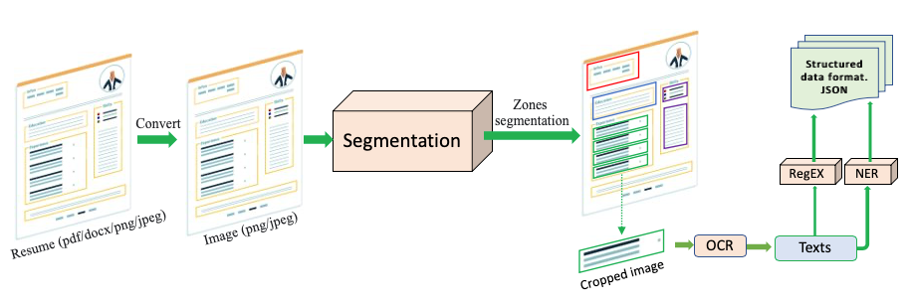
Block Diagram:

Slide 15
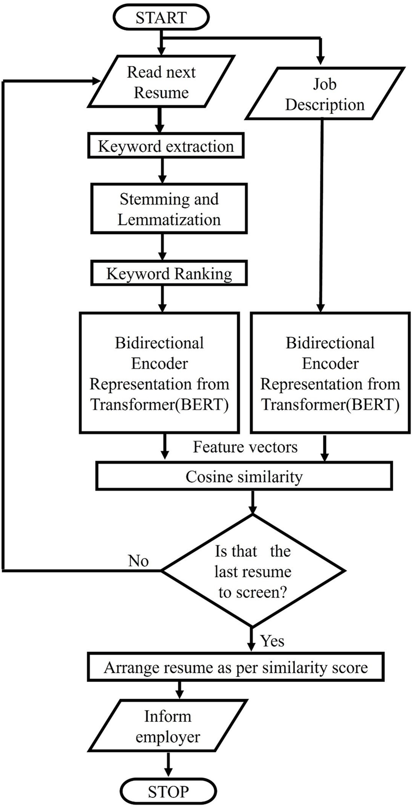
Architecture Diagram:

Slide 16
Modules :
User Interface Module
Purpose: Web interface for user interaction.
Functions:
Upload resume and input job description.
Display analysis results and enhancement suggestions.
Allow resume edits and downloads.
Resume Enhancement Module
Purpose: Helps users upgrade their resume to align with specific job roles.
Functions:
Suggest better bullet points and summaries.
Recommend skill additions or phrasing changes.

Slide 17
Modules :
AI Analysis & Matching Module
Purpose: Core engine powered by the Google Gemini API.
Functions:
Parse resumes into structured data.
Understand job descriptions (extract key skills, roles, qualifications).
Match resume data with job requirements.
Generate improvement feedback.

Slide 18
Proposed Algorithm:
Text Preprocessing Algorithm – Uses tokenization, stopword removal, and lemmatization to clean resume and job description text.
TF-IDF (Term Frequency-Inverse Document Frequency) – Identifies important keywords by analyzing word frequency and relevance.
Cosine Similarity Algorithm – Measures the similarity between resumes and job descriptions by converting text into numerical vectors
Skill Gap Analysis Algorithm – Compares job-required skills with those mentioned in the resume and highlights missing skills.
Candidate Ranking Algorithm – Combines similarity scores and skill match percentages to rank candidates effectively.

Slide 19
Hardware Required:
Component | Specification
Processor | Intel Core i5 or higher / AMD Ryzen 5 or higher
RAM | Minimum 8 GB (Recommended: 16 GB)
Hard Disk | Minimum 500 GB HDD or 256 GB SSD
Graphics | Integrated graphics sufficient; GPU (optional) for training large models
Monitor | Minimum resolution 1366x768 (Recommended: 1920x1080)
Peripherals | Keyboard, Mouse, Speakers (for interface testing)
Internet | Required for cloud-based deployment and dataset access

Slide 20
Software Required:
Software Component | Specification / Version
Operating System | Windows 10/11, Linux (Ubuntu 20.04+), or macOS
Programming Language | Python 3.7 or higher
Development Environment | VS Code, PyCharm
Machine Learning Libraries | Scikit-learn, Pandas, NumPy, Matplotlib, Seaborn
Web Framework | Flask or Streamlit (for web interface deployment)
Version Control | Git, GitHub (for source code management)
Browser | Google Chrome / Mozilla Firefox (for testing UI)

Slide 21
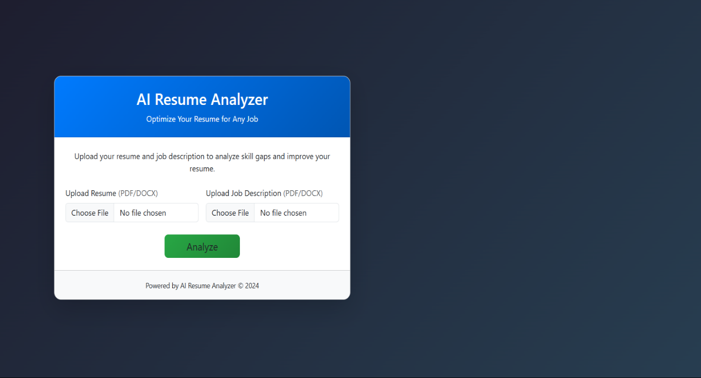
Implementation:

Slide 22
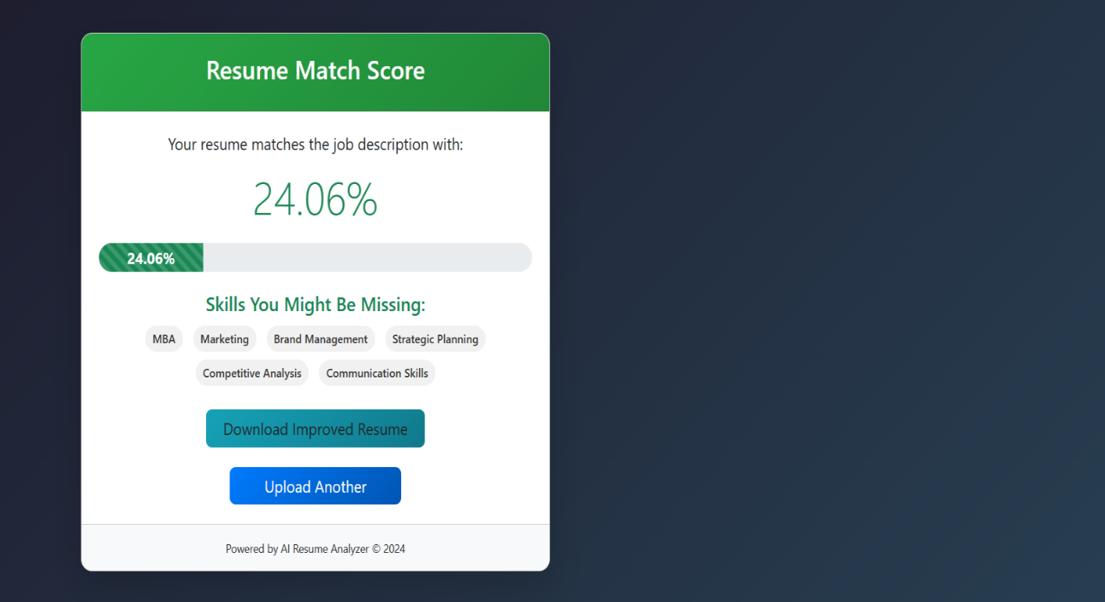
Implementation:

Slide 23
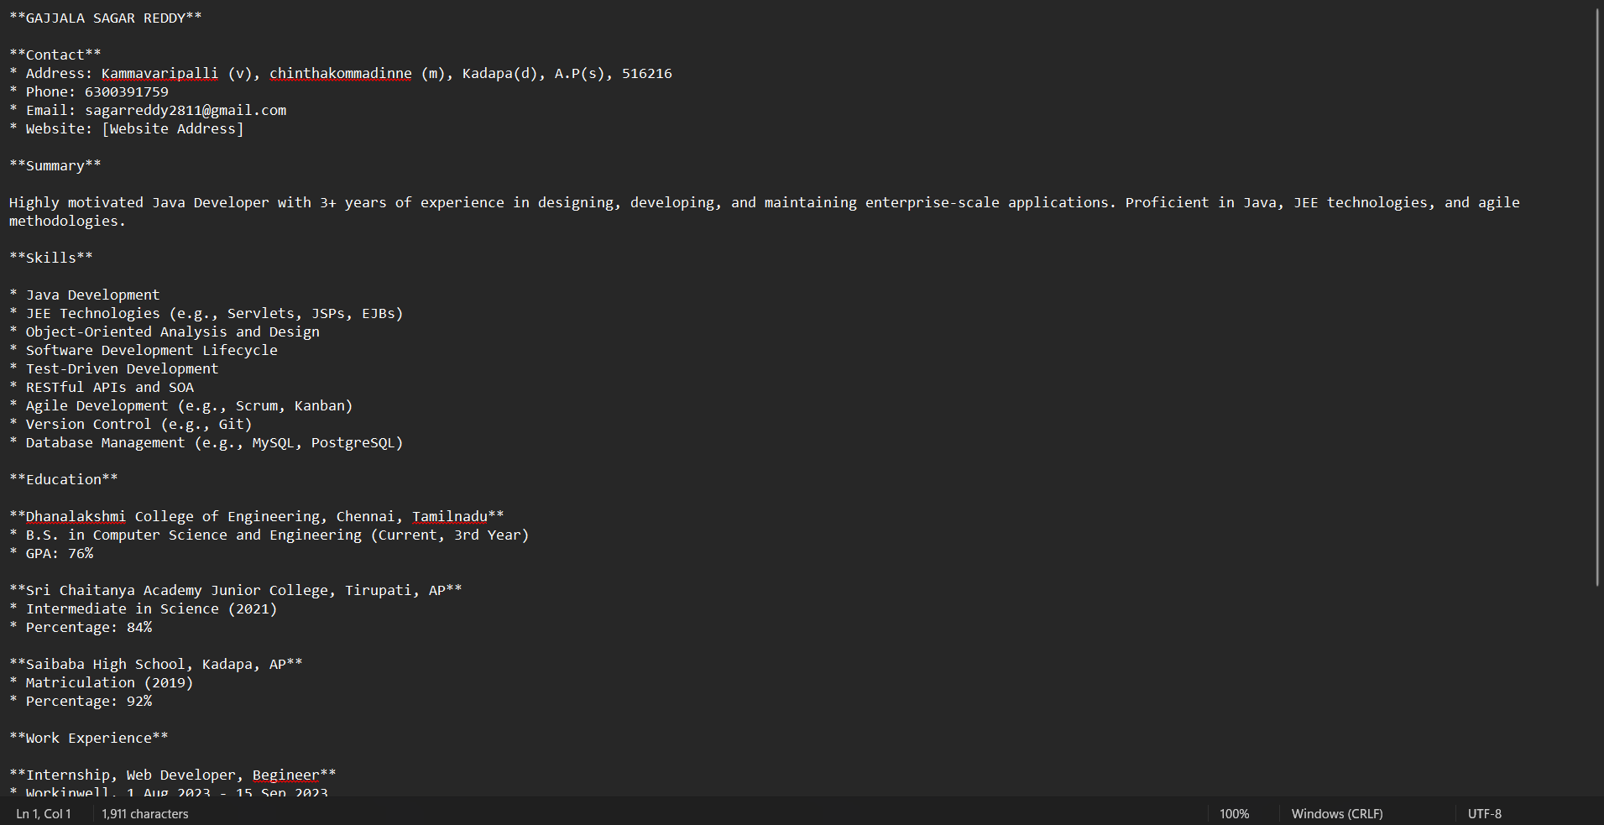
Implementation:

Slide 24
Conclusion:
The AI Resume Analyzer is a smart, automated solution designed to streamline and enhance the recruitment process by leveraging Natural Language Processing (NLP) and Machine Learning techniques. By using TF-IDF, Cosine Similarity, and Skill Gap Analysis, the system efficiently compares resumes with job descriptions, ranks candidates based on their relevance, and highlights missing skills. This approach eliminates manual screening, reduces unconscious bias, and improves hiring efficiency, allowing recruiters to focus on high-quality candidates rather than spending excessive time on resume filtering

Slide 25
Future Enhancements:
User Accounts and Dashboards: A secure login system could allow users to track previous resume submissions, see enhancement history, and save multiple versions of their resume for different job profiles.
Integration with Job Boards and APIs: Connecting to APIs from job portals such as LinkedIn, Indeed, or Glassdoor could enable real-time job description imports and easier application submission workflows.
Dynamic AI Feedback Loop: Collecting anonymised feedback on how AI-enhanced resumes perform in real-world job applications could train and fine-tune future LLM prompt models for even better results.
Industry-Specific Enhancement Modules: Tailoring resume enhancement logic based on the domain (e.g., IT, healthcare, education) can offer more contextually appropriate suggestions, improving alignment with industry expectations.

Slide 26
References:
S. Mittal, A. K. Mishra, V. Tripathi, P. Singh and P. Pandey, "A Comparative Analysis of Supervised Machine Learning Models for Smart Intrusion Detection in IoT Network," 2023 3rd Asian Conference on Innovation in Technology (ASIANCON), Ravet IN, India, 2023, pp. 1-6.
M. Wazid, J. Singh, A. K. Das, and J. J. Rodrigues, ‘An EnsembleBased Machine Learning-Envisioned Intrusion Detection in Industry 5.0-Driven Healthcare Applications’, IEEE Transactions on Consumer Electronics, 2023.
Smith, A. (2022). How AI is Transforming Recruitment: Benefits and Challenges. Journal of Human Resource Innovation, 15(3), 45–58.Discusses how AI-powered recruitment tools improve hiring efficiency and reduce bias
Brown, K., & Davis, M. (2021). Leveraging AI for Talent Acquisition: Case Studies and Best Practices. HR Technology Insights, 7(2), 30–40.Provides real-world case studies on AI-driven hiring solutions and their impact.
Wang, T., & Li, X. (2021). Natural Language Processing Techniques for Resume Analysis. AI & Employment Journal, 14(2), 33–47.Investigates NER (Named Entity Recognition) and deep learning for resume parsing.
Patel, S., & Gupta, R. (2020). AI Applications in Human Resource Management. Computational HR Journal, 10(1), 20–35.Examines AI-driven HR automation for resume screening and candidate shortlisting.
Sharma, R. (2020). Using TF-IDF and Cosine Similarity for Text Matching in Recruitment Systems. International Journal of Data Science and Applications, 9(4), 15–25.Explores how TF-IDF and Cosine Similarity improve resume-job description matching.

Slide 27
References:
8. Kim, J., & Roberts, M. (2019). Machine Learning Approaches for Recruitment Optimization. Journal of AI Research, 12(5), 67-82.Discusses machine learning models, including decision trees and deep learning, for resume ranking.
9. Jurafsky, D., & Martin, J. H. (2019). Speech and Language Processing (3rd ed.). Pearson.Explains NLP techniques such as tokenization, lemmatization, and stopword removal used in resume analysis.
10. M. Bhandarkar, "MapReduce programming with apache Hadoop," 2010 IEEE International Symposium on Parallel & Distributed Processing (IPDPS), Atlanta, GA, USA, 2010, pp. 1-1.
11. Manning, C. D., Raghavan, P., & Schütze, H. (2008). Introduction to Information Retrieval. Cambridge University Press.Covers information retrieval methods, including TF-IDF and Cosine Similarity, for text matching.
12. K. Chowdhary and K. R. Chowdhary, ‘Natural language processing’, Fundamentals of artificial intelligence, pp. 603–649, 2020.
13. J. Dean and S. Ghemawat, “MapReduce: Simplified Data Processing on Large Clusters,” 2004. Available: https://static.googleusercontent.com/media/research.google.com/en//a rchive/mapreduce-osdi04.pdf
14. spaCy Documentation (n.d.). Industrial-Strength Natural Language Processing in Python. Retrieved from https://spacy.io.Covers text preprocessing techniques used for cleaning resumes and extracting important terms.
15. Indeed.com (n.d.). Recruitment Challenges and How Technology is Solving Them. Retrieved from https://www.indeed.com.

Slide 28
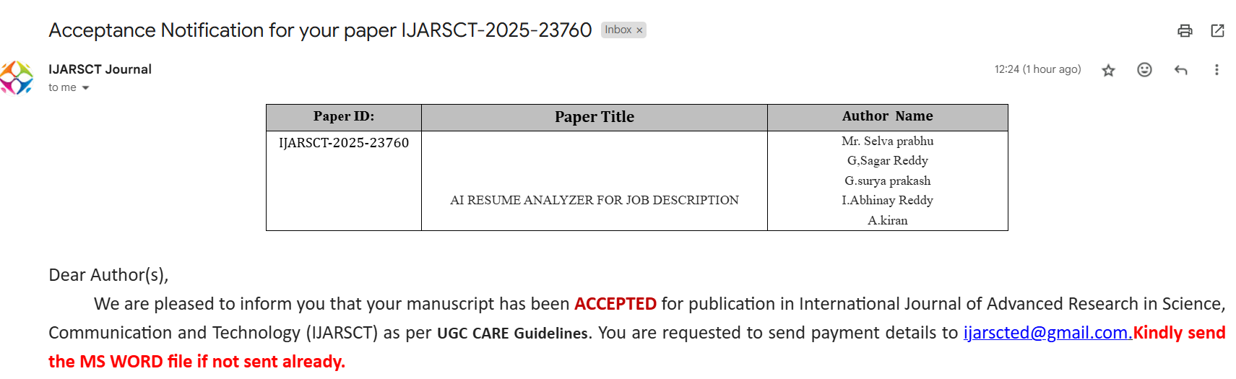
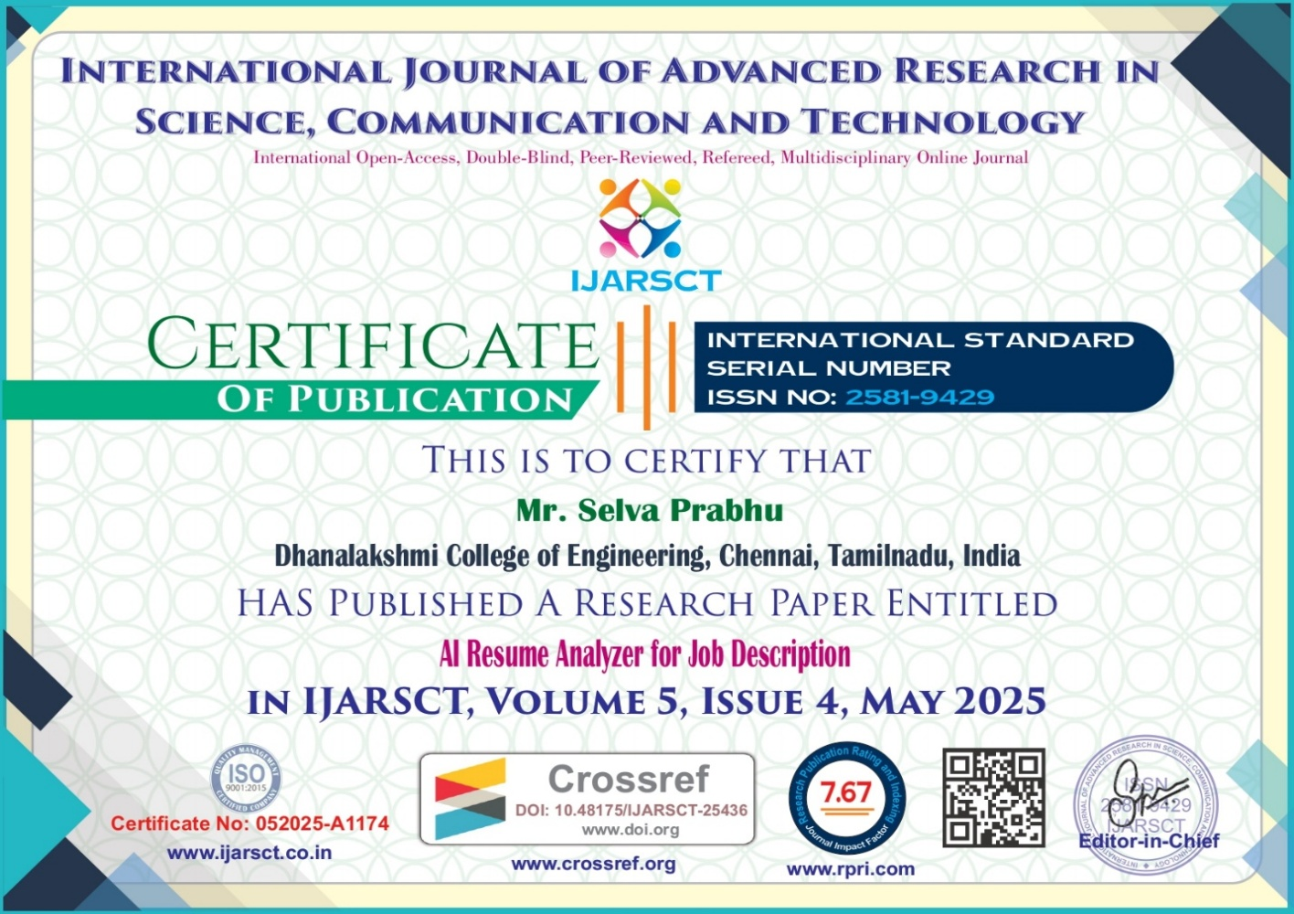
Conference Certificates:

Slide 29

Conference Certificates:

Slide 30
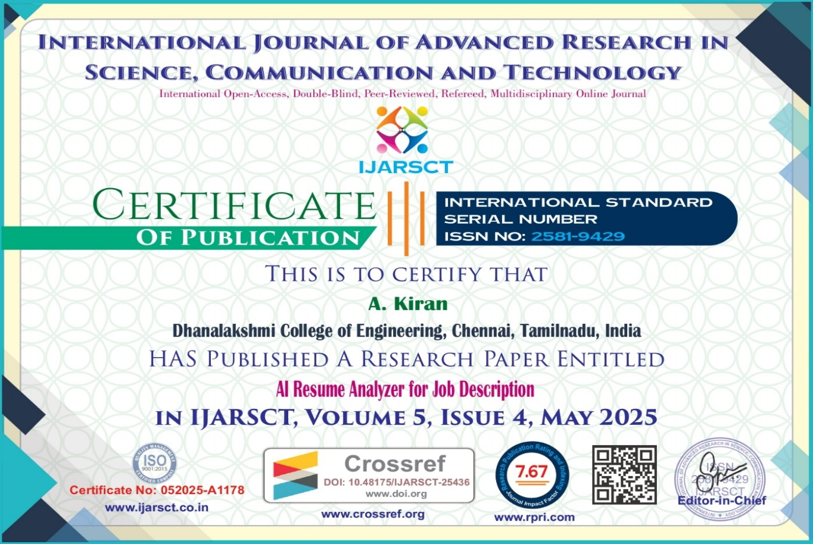

Conference Certificates:

Slide 31



